Slide 1
Differentiation
First Principles & Implicit Differentiation

Slide 2
First Principles
What is differentiation?
Gradients
Rates of Change
First Principles

Slide 3
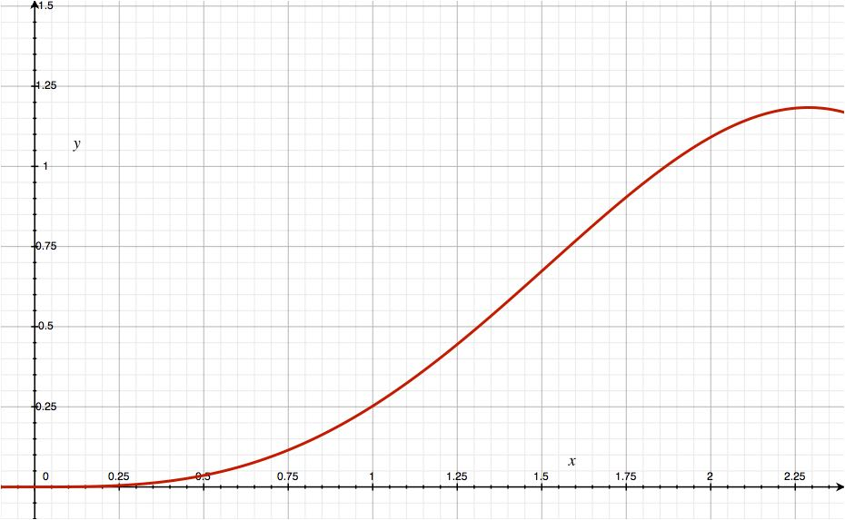
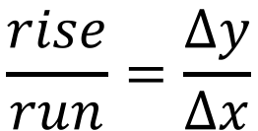
Gradient
$$\frac{rise}{run}=\frac{Δy}{Δx}$$
Not that great.

Slide 4
Gradient
$$\frac{rise}{run}=\frac{Δy}{Δx}$$
Better.

Slide 5
Gradient
$$\frac{rise}{run}=\frac{Δy}{Δx}$$
Even better again.

Slide 6
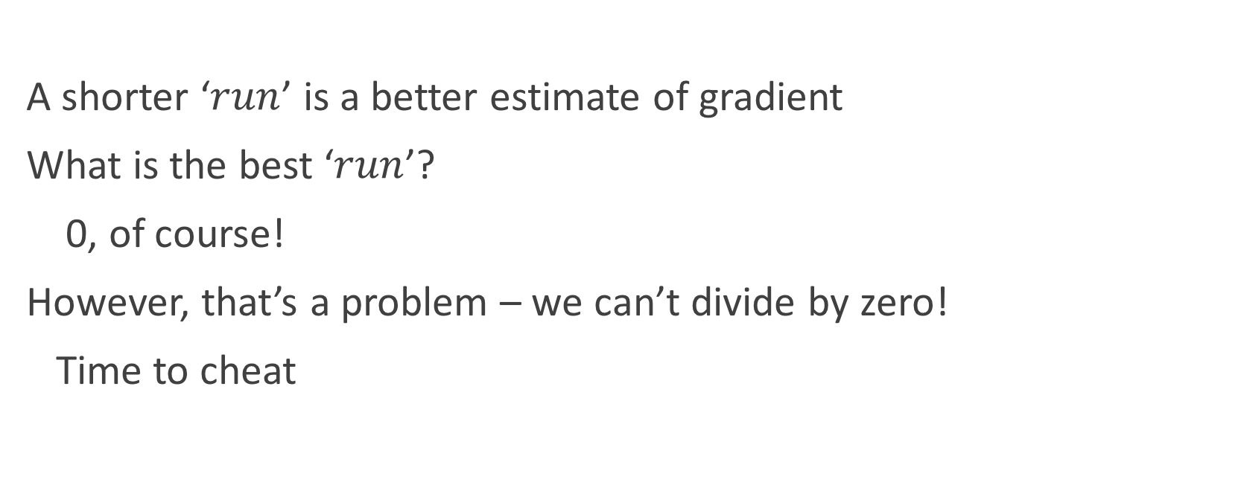
Gradient
A shorter ‘$run$’ is a better estimate of gradient
What is the best ‘$run$’?
0, of course!
However, that’s a problem – we can’t divide by zero!
Time to cheat

Slide 7





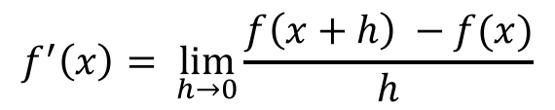
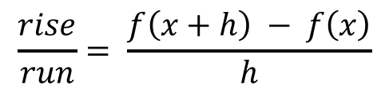
First Principles
We start with the curve $f(x)$, and our $run$ of $h$
The $rise$ is the change in $f$ over the duration of the $run$
$rise=f\left(x+h\right)−f\left(x\right)$
This means we have
To make $h=0$, we write (using limits)
$$f(x+h)$$
$$\frac{rise}{run}= \frac{f\left(x+h\right) − f\left(x\right)}{h}$$
$$f\left(x+h\right)−f(x)$$
$$f^{′}\left(x\right)= \lim_{h→0}{\frac{f\left(x+h\right) −f(x)}{h}}$$
$$f(x)$$
$$h$$
Notes:
Explain the concept of a limit:
We can’t use the actual value we want, so we use ‘close enough’ – or, algebra!

Slide 8
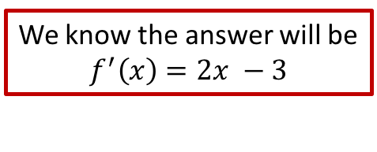
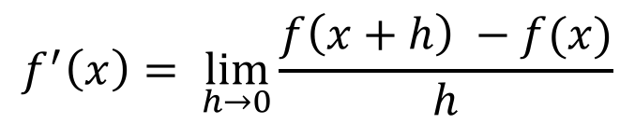
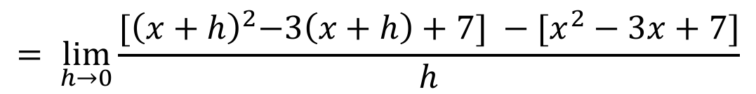
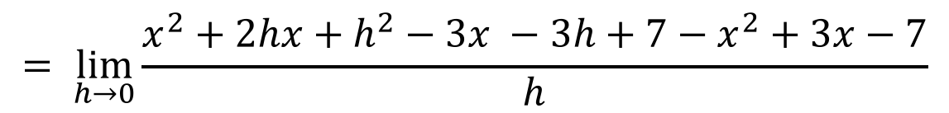
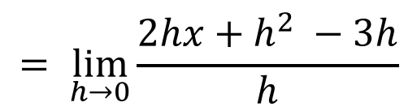
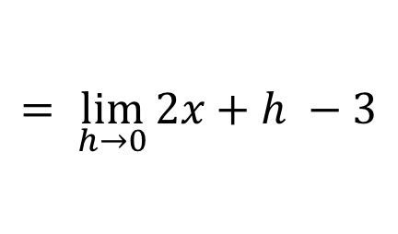
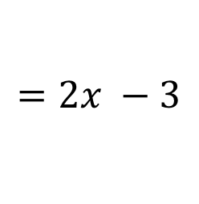
Example 1
We know the answer will be
$$f^{′}\left(x\right)=2x −3$$
Find the derivative of ${f\left(x\right)=x}^{2}−3x+7$ using first principles.
$$f^{′}\left(x\right)= \lim_{h→0}{\frac{f\left(x+h\right) −f(x)}{h}}$$
$$= \lim_{h→0}{\frac{{[\left(x+h\right)}^{2}−3\left(x+h\right)+7] −[x^{2}−3x+7]}{h}}$$
$$= \lim_{h→0}{\frac{x^{2}+2hx+h^{2}−3x −3h+7−x^{2}+3x−7}{h}}$$
$$= \lim_{h→0}{\frac{2hx+h^{2} −3h}{h}}$$
$$= \lim_{h→0}{2x+h −3}$$
$$=2x −3$$
Notes:
May need to talk more about the substitution and the cancelling.

Slide 9
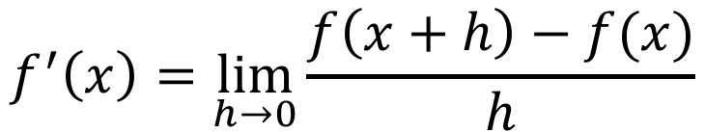
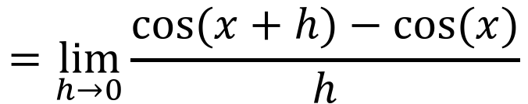
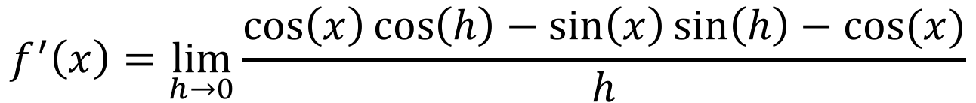
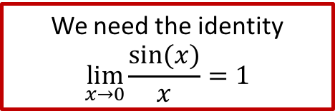
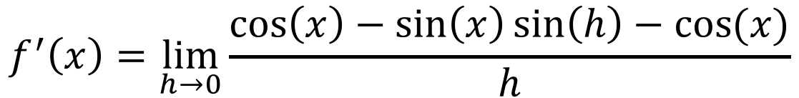
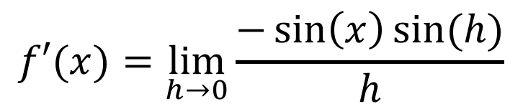


Example 2
We need the identity
$$\lim_{x→0}{\frac{sin⁡(x)}{x}=1}$$
Find the derivative of $f(x) = cos⁡(x)$using first principles.
$$f^{′}\left(x\right)=\lim_{h→0}{\frac{f\left(x+h\right)−f(x)}{h}}$$
$$=\lim_{h→0}{\frac{\cos{(x+h)}−\cos{(x)}}{h}}$$
$$f^{′}\left(x\right)=\lim_{h→0}{\frac{\cos\left(x\right)\cos\left(h\right)−\sin\left(x\right)\sin\left(h\right)−\cos{(x)}}{h}}$$
$$f^{′}\left(x\right)=\lim_{h→0}{\frac{\cos\left(x\right)−\sin\left(x\right)\sin\left(h\right)−\cos{(x)}}{h}}$$
$$f′(x)=\lim_{h→0}{\frac{−\sin\left(x\right)\sin{(h)}}{h}}$$
$$=−sin⁡(x)$$

Slide 10
Practice
Delta Workbook
Exercise 5.7, page 77
Workbook
Pages 15-20

Slide 11
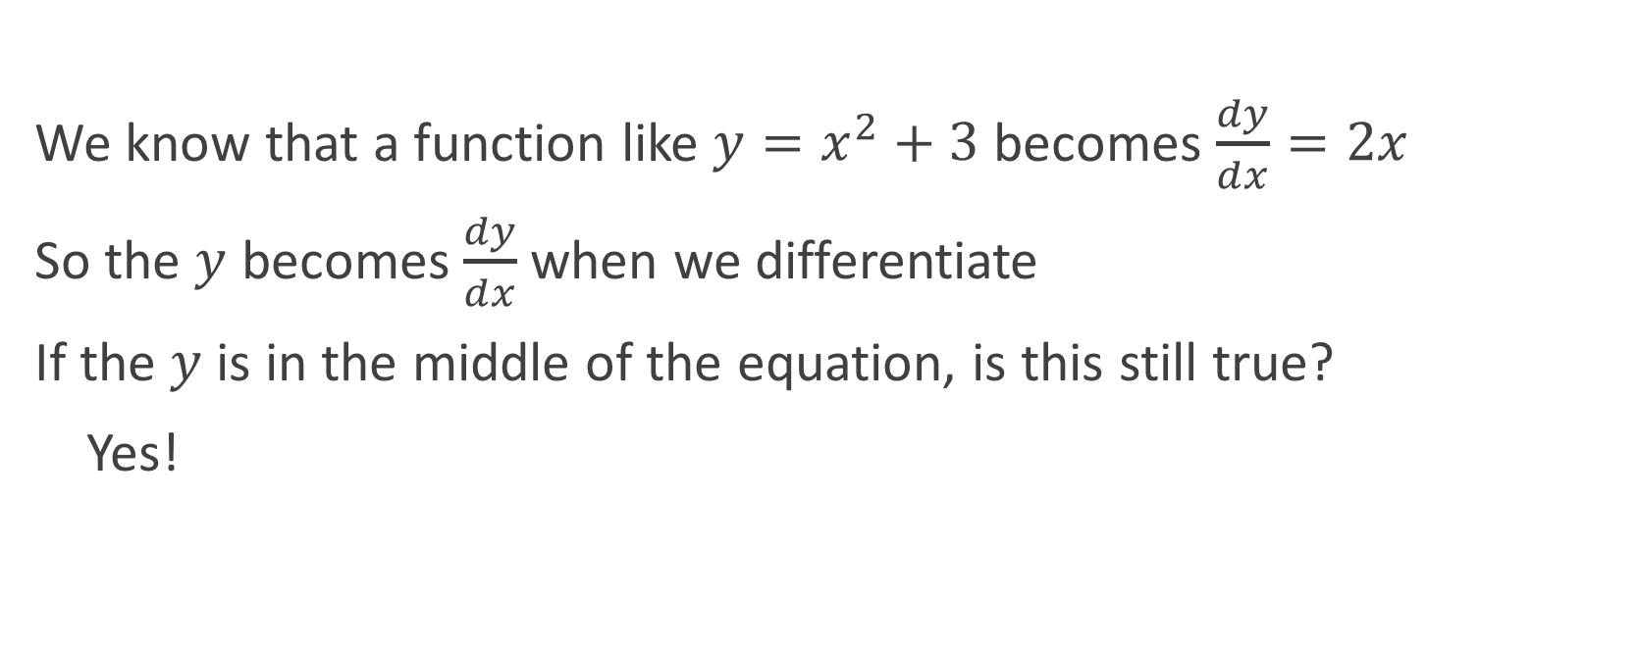
Implicit Differentiation
We know that a function like $y=x^{2}+3$ becomes $\frac{dy}{dx}=2x$
So the $y$ becomes $\frac{dy}{dx}$ when we differentiate
If the $y$ is in the middle of the equation, is this still true?
Yes!

Slide 12





Example 1
This equation is the same as
$$y=\frac{−x^{2}}{2}−4$$
Differentiate implicitly: $x^{2}+2y+4=0$
$$2x+2\frac{dy}{dx}=0$$
$$2\frac{dy}{dx}=−2x$$
$$\frac{dy}{dx}=−x$$

Slide 13
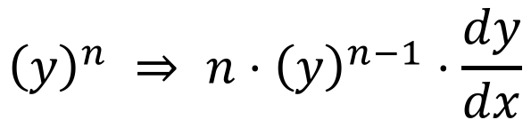
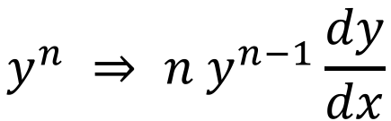

Implicit Differentiation
What if we have more than one $y$, e.g. $y^{2}$?
We can use the chain rule!
$${\left(y\right)}^{n} ⇒ n⋅{\left(y\right)}^{n−1}⋅\frac{dy}{dx}$$
$$y^{n} ⇒ n y^{n−1}\frac{dy}{dx}$$

Slide 14
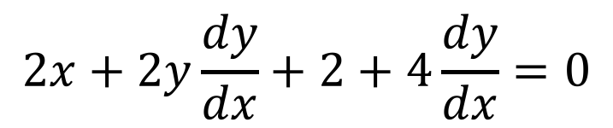
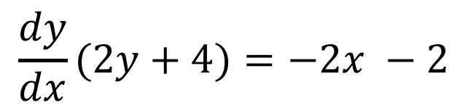
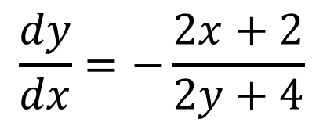
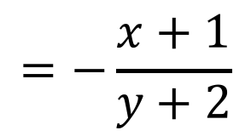

Example 2
This is really horrible to rearrange – use implicit differentiation!
$$x^{2}+y^{2}+2x+4y−16=0$$
Differentiate
$$2x+2y\frac{dy}{dx}+2+4\frac{dy}{dx}=0$$
$$\frac{dy}{dx}(2y+4)=−2x −2$$
$$\frac{dy}{dx}=−\frac{2x+2}{2y+4}$$
$$=−\frac{x+1}{y+2}$$
There is still a $y$ in the answer – this is allowed!

Slide 15
Practice
Delta Workbook
Exercise 13.1, page 139
Workbook
Pages 27-31, 32-35 (harder)

Slide 16
Do Now
Any Questions?
Delta Workbook
Exercises 5.7, 13.1
Workbook
Pages 15-20, 27-35

Slide 17

This work is licensed under a Creative Commons Attribution-NonCommercial-ShareAlike 4.0 International License.
Aaron Stockdill
2016

